Slide 1
Logistic Regression Theory

Slide 2
1) Estimating the conditional expectations of continuous variables (as in regression), or at estimating distributions.
2) output variable is discrete rather than continuous - Classification / Logistic

Slide 3
conditional probability

Slide 4
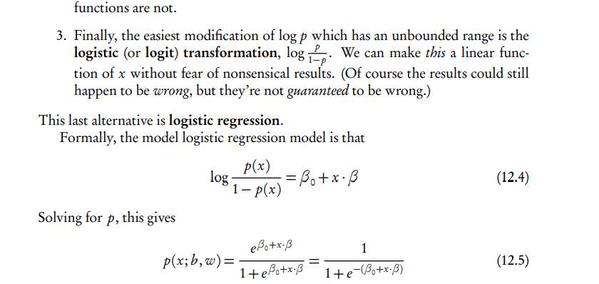
Logistic

Slide 5
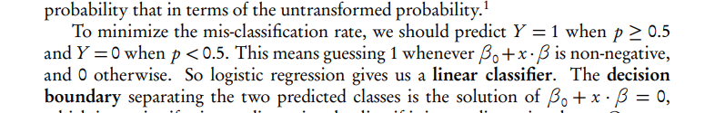
Linear classifier

Slide 6
Logistic Regression with More Than Two Classes

Slide 7
Generalized linear models
Logistic regression is part of a broader family of generalized linear models (GLMs), where the conditional distribution of the response falls in some parametric family, and the parameters are set by the linear predictor.

Slide 8
Logistic regression is the case where the response is binomial.
Changing the relationship between the parameters and the linear predictor is called changing the link function.
R = glm()
logr = glm(y.1 ~ x[,1] + x[,2], family=binomial)

Slide 9
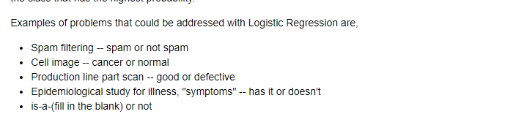

Slide 10
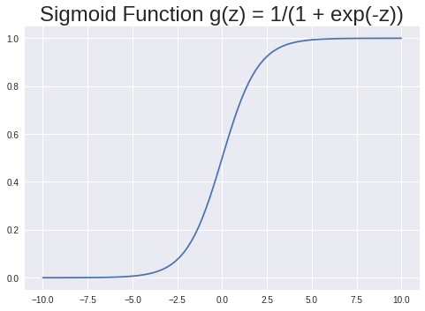

Slide 11
Decision Boundary
Cost Function

Slide 12
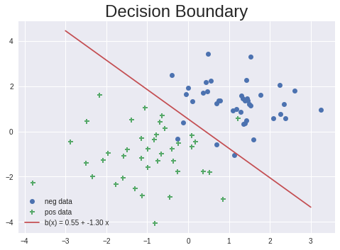

Slide 13
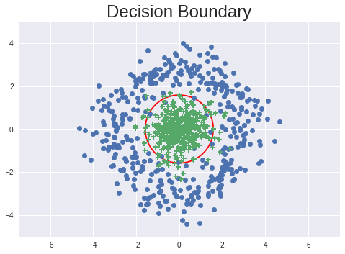

Slide 14
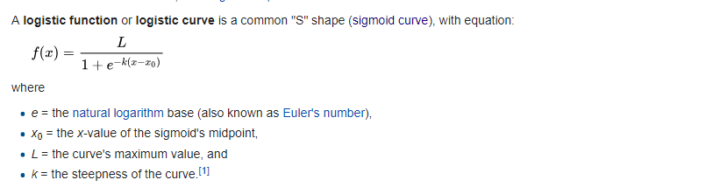

Slide 15
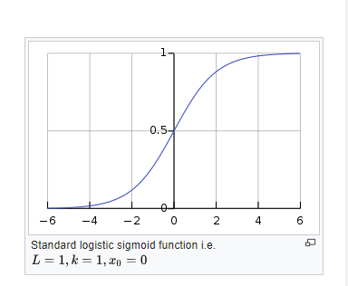

Slide 16
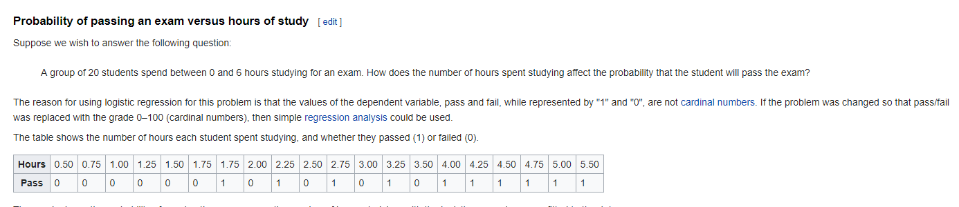

Slide 17
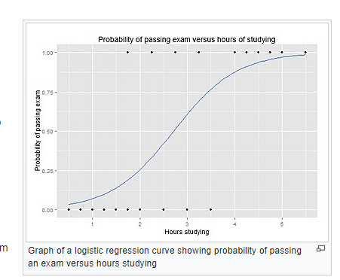

Slide 18
Description
Compute the logit transformation of proportions or percentages.
Usage
logit(p, percents=max(p, na.rm = TRUE) > 1, adjust)

Slide 19
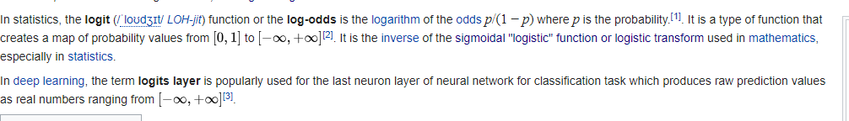

Slide 20


Slide 21
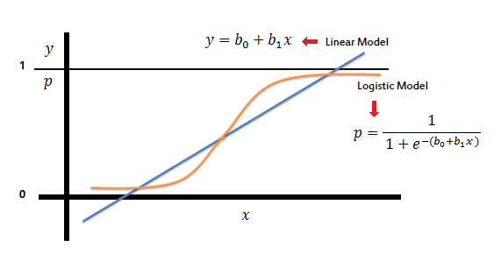

Slide 22
Logistic or logit ??

Slide 23
logistic optimization model
Model Optimisation

Slide 24
receiver operating characteristic curve, i.e., ROC curve
ROC curve, is a graphical plot that illustrates the diagnostic ability of a binary classifier system as its discrimination threshold is varied.

Slide 25
The ROC curve is created by plotting the true positive rate (TPR) against the false positive rate (FPR) at various threshold settings.
Area under the curve
The Total Operating Characteristic (TOC) also characterizes diagnostic ability while revealing more information than the ROC.

Slide 26
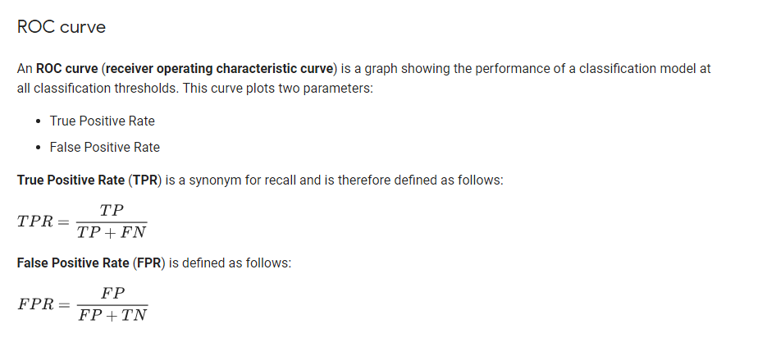

Slide 27
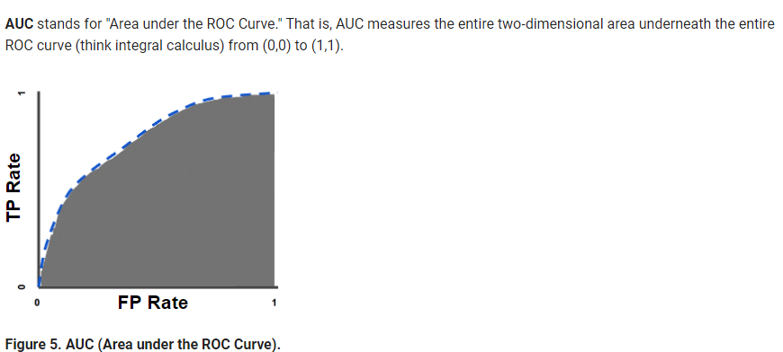

Slide 28

Estimating the classification model hit ratio
classification accuracy
confusion matrix

Slide 29
Precision is the
number of True Positives
divided by
the number of True Positives and False Positives.

Slide 30
Recall is the
number of True Positives
divided by
the number of True Positives and the number of False Negatives.

Slide 31
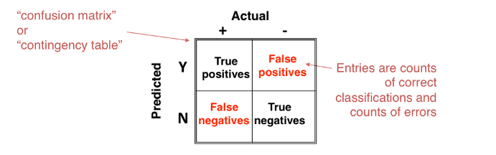

Slide 32
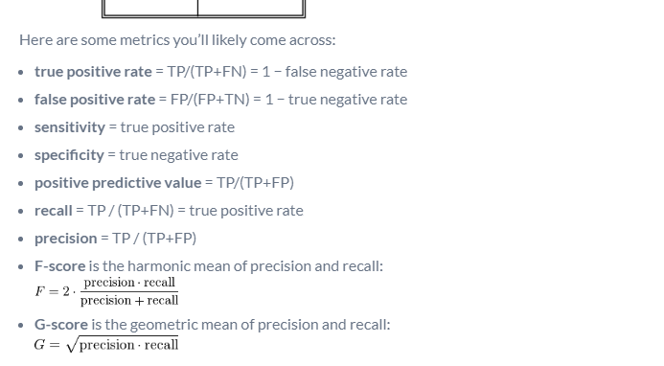

Slide 33
isolating classifier for optimum results

Slide 34
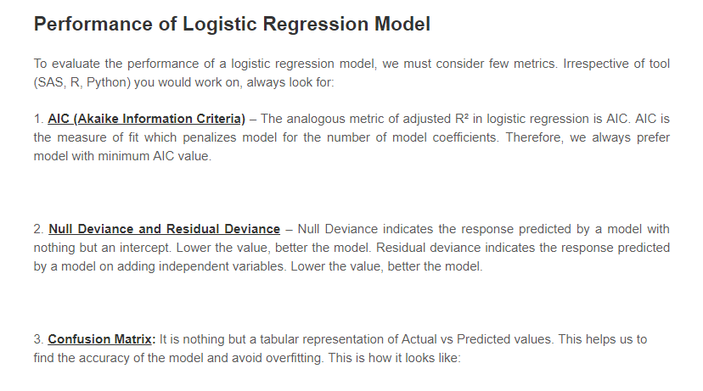

Slide 35
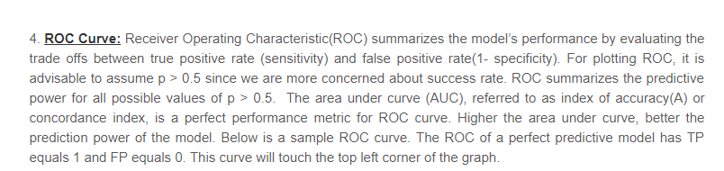

Slide 36
Maximum Likelihood Estimation

Slide 37
Deviance
We see the word Deviance twice over in the model output. Deviance is a measure of goodness of fit of a generalized linear model. Or rather, it’s a measure of badness of fit–higher numbers indicate worse fit.
R reports two forms of deviance – the null deviance and the residual deviance. The null deviance shows how well the response variable is predicted by a model that includes only the intercept (grand mean).

Slide 38
Fisher Scoring
What about the Fisher scoring algorithm? Fisher’s scoring algorithm is a derivative of Newton’s method for solving maximum likelihood problems numerically.

Slide 39
Akaike Information Criterion (AIC) provides a method for assessing the quality of your model through comparison of related models.

